Slide 1
Speed Dating
Data Science Presentation

Slide 2
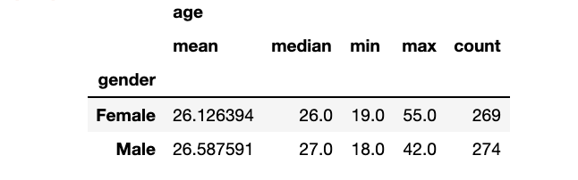
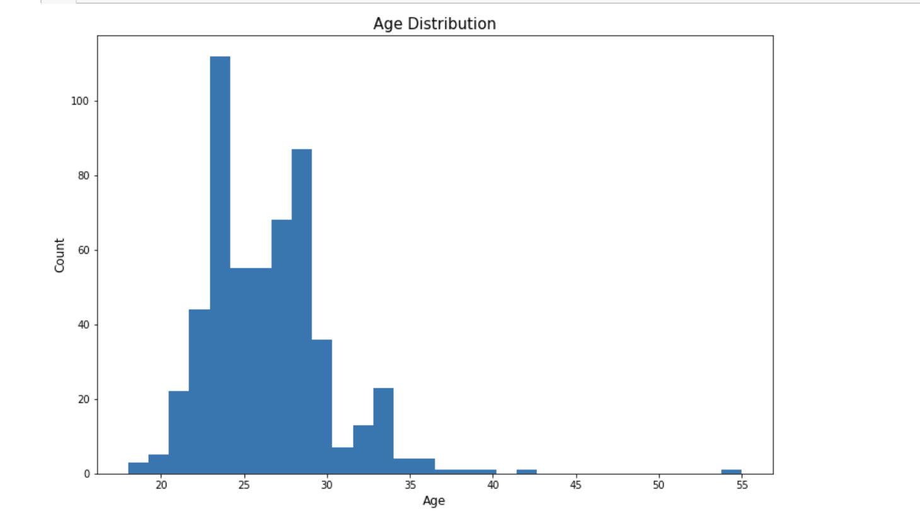
The Audience
The Study is made on 8378 persons with multiple rounds as the “wave” information indicate.
The real number of participants that is equal to 551.
The number of Males is 277 and he number of Females is 274.

Slide 3
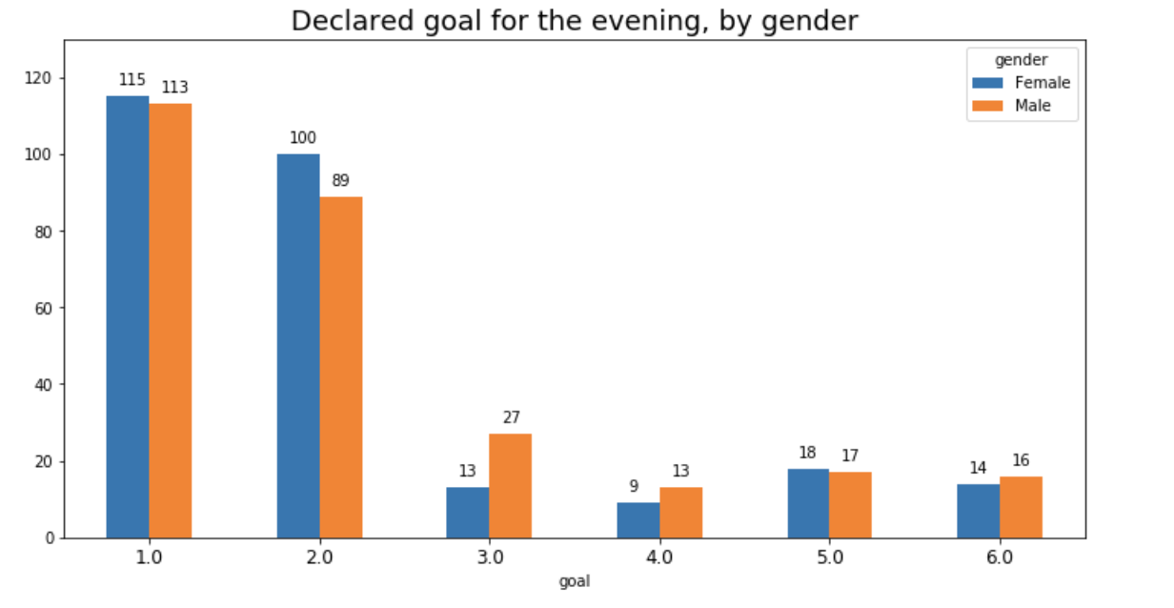
Goal for the participant
FUN | 228
MEET | 189
DATE | 40
I DID IT | 35
OTHER | 30
RELASHIONSHIP | 22
N/A | 7

Slide 4
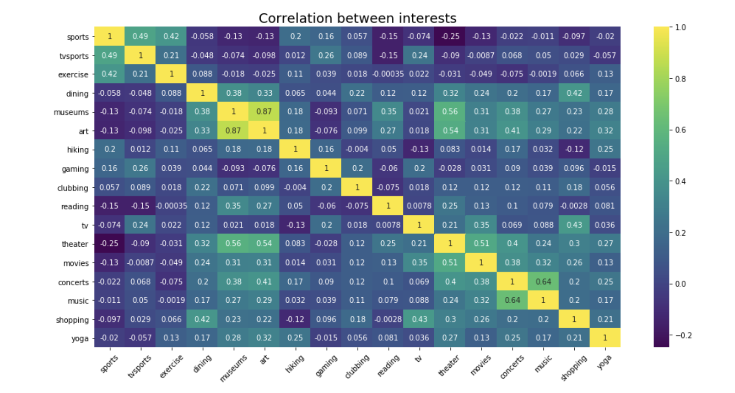
Matching Factors
Museum Vs Art | 0,87
Music Vs Concert | 0,64
Theater Vs Art | 0,54
Theater Vs Museum | 0,56
Theater Vs Movies | 0,51
Tv Sports Vs Sports | 0,49
Tv Vs shopping | 0,43
Dining Vs Shopping | 0,42
Exercise Vs Sports | 0,42

Slide 5
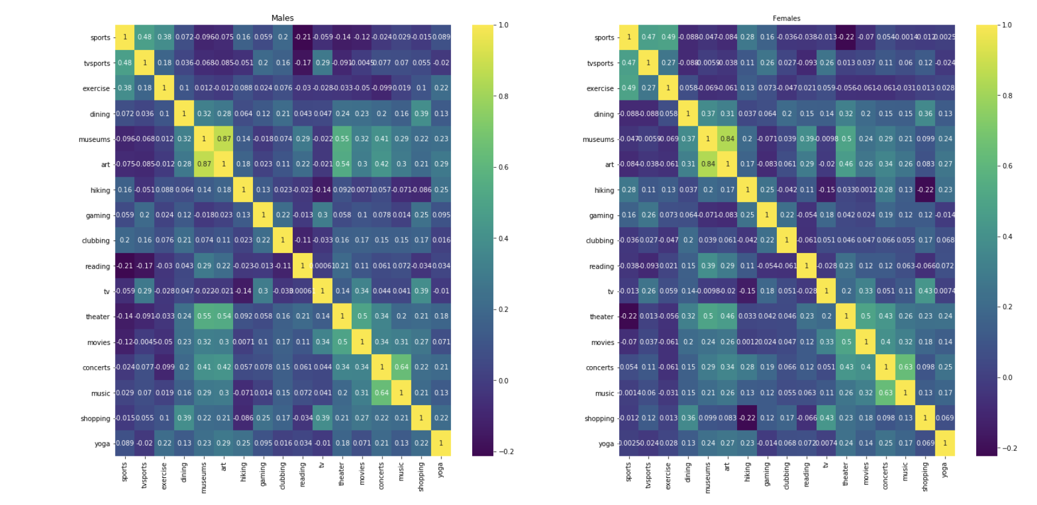


Matching Factors Per Sex
The Interest factor is highly correlated between sex as we can see the same highlight spots in the same places for both sex.

Slide 6
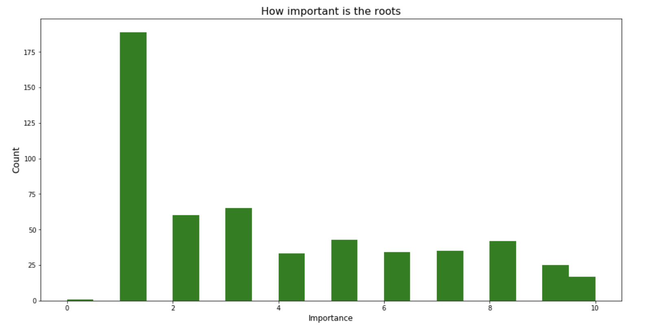
How important are the Roots?
People declaring how important is the roots when selecting a partner

Slide 7
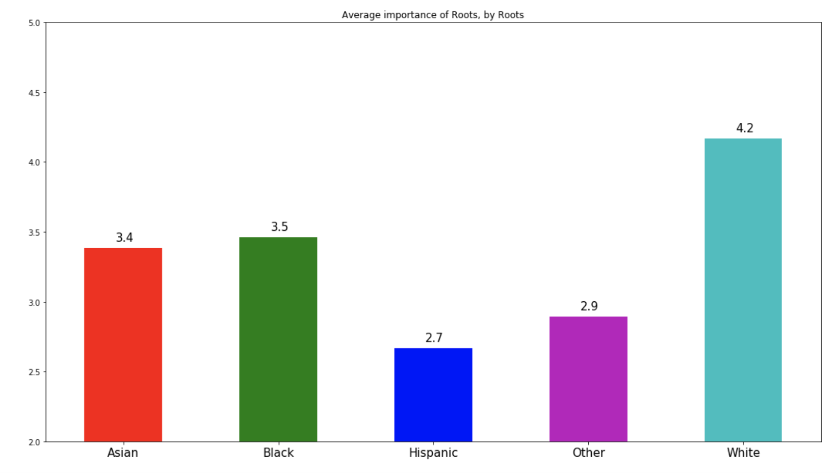
Interested by Roots per Roots
Total people interested of roots by roots
Average importance of roots by roots
Asian | 136
White | 304
Other | 43
Hispanic | 42
Black | 26

